Slide 1

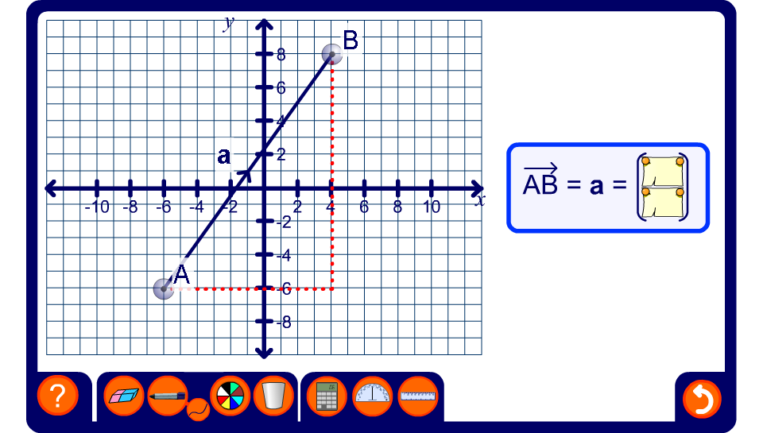


Representing vectors
Notes:
Drag the end-points of the vector to modify it. Ask pupils to tell you the values of the horizontal and vertical components. If required the coordinates of A and B can be revealed and these can be used to find the vector.
The activity can also be used to ask volunteer to come to the board to demonstrate a given vector.
Stress that vectors, unlike coordinates, are not fixed to a particular position on the grid. The same vector can be placed in any position on the grid. Demonstrate this by dragging the centre of the vector to move it to a variety of positions on the grid. Make sure that that the value of the vector is revealed and observe that it does not change.

